Slide 1


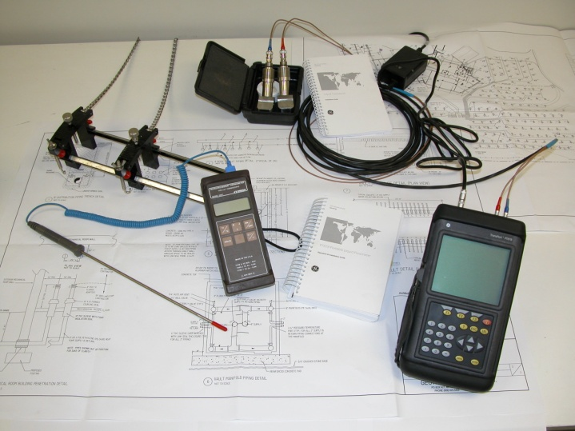
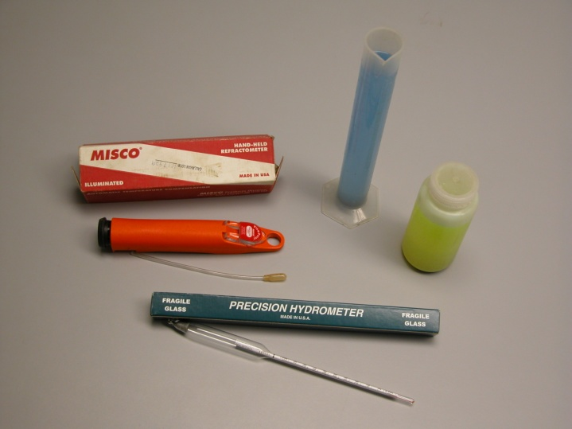
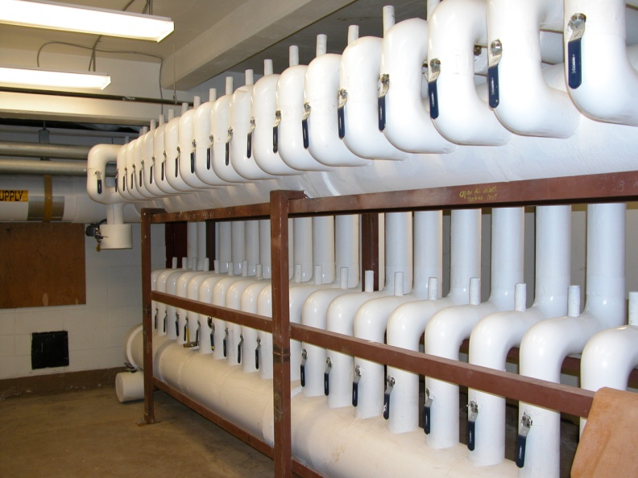
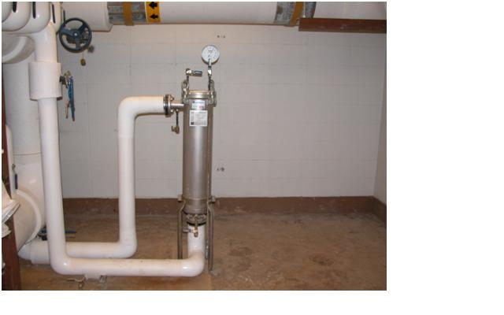
Home - About GSS - Services - Resources - Contact Us
Ground Source Solutions
Founded in 2003, Ground Source Solutions, LLC (GSS) provides comprehensive diagnostic and maintenance services for vertical closed loop, ground coupled, geothermal heat exchangers. GSS was formed by the management of Geothermal Services, Inc. in response to the growth in large scale commercial geothermal projects and the need expressed by clients to ensure the long term performance of these systems
GSS Mission Statement:
To promote optimum performance of commercial geothermal loop systems by providing top quality inspection and maintenance services.
We will provide these services in the most highly professional and ethical manner by always treating the client’s best interest as our top priority.

Slide 2
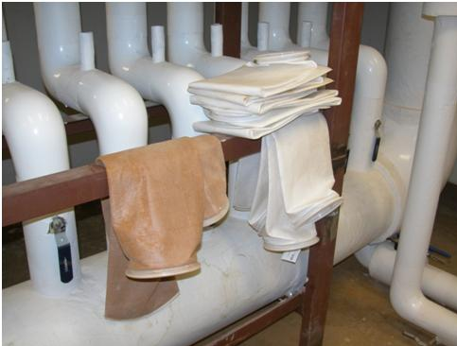
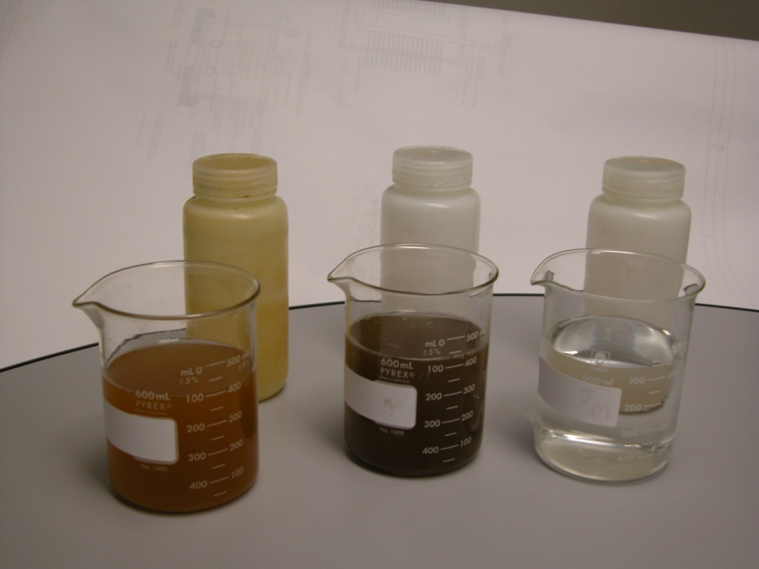
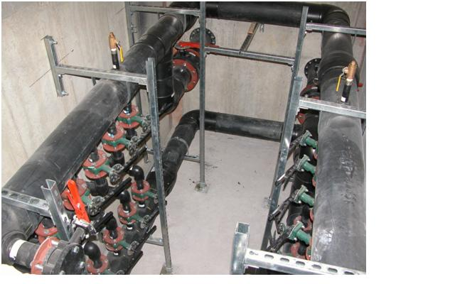
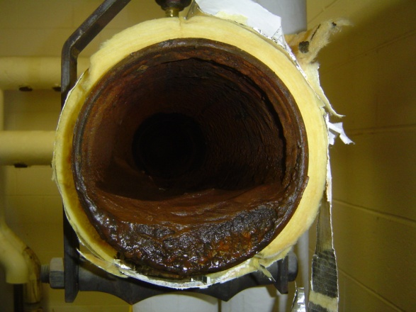
Home - About GSS - Services - Resources - Contact Us
Ground Source Solutions
Founded in 2003, Ground Source Solutions, LLC (GSS) provides comprehensive diagnostic and maintenance services for vertical closed loop, ground coupled, geothermal heat exchangers. GSS was formed by the management of Geothermal Services, Inc. in response to the growth in large scale commercial geothermal projects and the need expressed by clients to ensure the long term performance of these systems
GSS Mission Statement:
To promote optimum performance of commercial geothermal loop systems by providing top quality inspection and maintenance services.
We will provide these services in the most highly professional and ethical manner by always treating the client’s best interest as our top priority.

Slide 3
Flow Testing
Antifreeze Testing
Manifold Inspections
System Fluid Filtration

Slide 4
System Fluid Filtration
Water Quality Testing
Manifold Inspections
System Fluid Filtration

Slide 5
Home - About GSS - Services - Resources - Contact Us
Ground Source Solutions
Founded in 2003, Ground Source Solutions, LLC (GSS) provides comprehensive diagnostic and maintenance services for vertical closed loop, ground coupled, geothermal heat exchangers. GSS was formed by the management of Geothermal Services, Inc. in response to the growth in large scale commercial geothermal projects and the need expressed by clients to ensure the long term performance of these systems
GSS Mission Statement:
To promote optimum performance of commercial geothermal loop systems by providing top quality inspection and maintenance services.
We will provide these services in the most highly professional and ethical manner by always treating the client’s best interest as our top priority.

Slide 6
Home - About GSS - Services - Resources - Contact Us
Ground Source Solutions
Founded in 2003, Ground Source Solutions, LLC (GSS) provides comprehensive diagnostic and maintenance services for vertical closed loop, ground coupled, geothermal heat exchangers. GSS was formed by the management of Geothermal Services, Inc. in response to the growth in large scale commercial geothermal projects and the need expressed by clients to ensure the long term performance of these systems
GSS Mission Statement:
To promote optimum performance of commercial geothermal loop systems by providing top quality inspection and maintenance services.
We will provide these services in the most highly professional and ethical manner by always treating the client’s best interest as our top priority.

Slide 7
Home - About GSS - Services - Resources - Contact Us
About the Company
This website is designed to provide current owners of geothermal loop systems with a comprehensive view of the regular maintenance required for vertical, closed loop, ground coupled heat exchangers. In order to achieve maximum operating efficiency geothermal systems must be inspected and maintained on a regular basis.
Larger system installations utilize computer based building automations systems that can effectively monitor system temperature and pressure fluctuations as well as equipment operations. However, building control systems cannot “see” inside the ground loop or interior mechanical piping and determine the condition of the loop fluid, or any corrective actions that may be needed. Only regular inspections, testing and monitoring will provide the information necessary to make informed decisions on maintenance requirements.

Slide 8
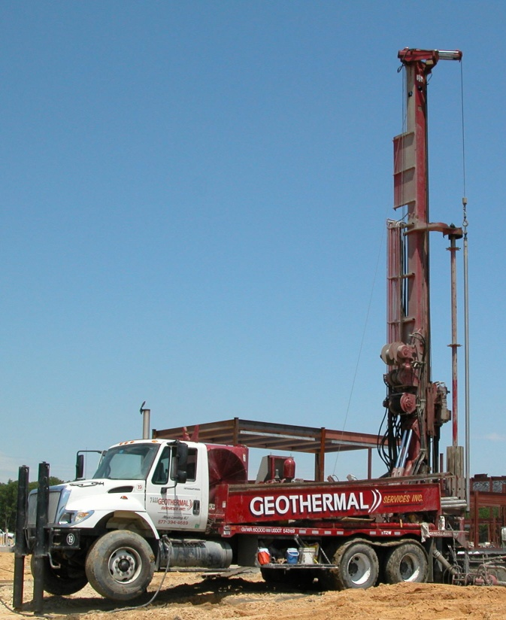
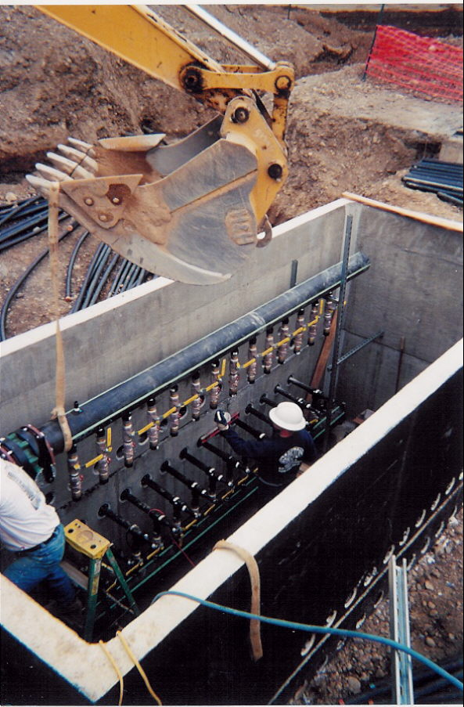
Home - About GSS - Services - Resources - Contact Us
Our Services
While geothermal systems typically have lower maintenance costs than most conventional heating and cooling systems, there are still regularly required practices and measures that must be employed in order to maintain optimum performance at the lowest cost. Regular inspections and monitoring of geothermal loop systems include:
  Water quality testing
  System fluid filtration
  Antifreeze testing
  Manifold inspections
  Underground vault inspections
  System pressure and flow testing.
Regular maintenance is the key to ensure the longevity of any heating and air conditioning system. Initial diagnostics are necessary to establish the baseline operating parameters of the system and to determine any corrective measures that may be necessary.

Slide 9
Home - About GSS - Services - Resources - Contact Us
Geothermal loop systems are constructed with high density polyethylene (HDPE) pipe and are typically connected to either copper or steel pipe inside a building. The fluid circulating through the system is either water or a water/antifreeze solution. Since either fluid circulating through copper or steel pipe will produce corrosion or scale over time, it is important to monitor the loop fluid chemistry and make adjustments as necessary to ensure problem free operation.
Water quality testing allows the loop fluid to be evaluated for levels of iron, silica, corrosion inhibitors, acidity and alkalinity (pH levels) as well as water hardness. Additional testing can also be performed to determine if iron bacteria is present in a closed loop system. Iron bacteria can produce a host of operational issues including clogged heat exchangers and pumping problems.
While initial commissioning of a geothermal loop system can eliminate most problems, regular water quality testing is critical to the long term operating efficiency of the system.
Water Quality Testing

Slide 10
Home - About GSS - Services - Resources - Contact Us
If corrosion is present in the geothermal loop fluid stream, in the form of suspended solids, it should be removed immediately. Ignoring this type of particulate matter has the potential to produce long term catastrophic results in any type of heating or cooling system, including geothermal heat pumps.
The simplest way to remove any type of particulate matter from a geothermal loop system is to flush and filter the fluid until it is clean and clear of any foreign material. This can be accomplished in one of two ways. The first option involves shutting down the entire system to completely flush and filter both the exterior geothermal loop field as well as the interior mechanical pipe loop inside the building. This option is typically used in an emergency situation if a system is experiencing problems or it is completed during a regularly scheduled maintenance shut down for a facility. Since this option can be both costly and impractical in certain situations, an alternative approach is to install a permanent “side stream” filter that has the ability to continuously filter the entire system.
System Fluid Filtration
This approach provides additional benefits for monitoring the system. A side stream filter can be inspected at regular intervals to evaluate filter conditions and to change disposable filters as needed. In addition, water samples can be obtained water quality testing at recommended intervals without interrupting normal system operations.

Slide 11
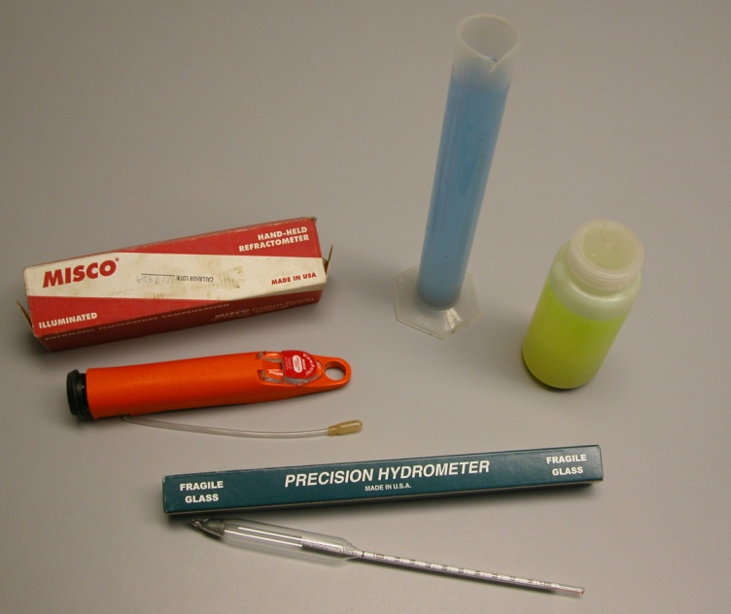
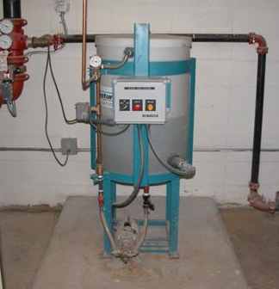
Home - About GSS - Services - Resources - Contact Us
Antifreeze Testing
Antifreeze solutions are commonly used in geothermal heat pump systems since loop temperatures can approach or even dip below freezing while providing heating during the winter months. The most commonly used antifreeze solutions in closed loop geothermal heat pump systems are propylene glycol and ethanol. Both environmentally friendly antifreeze solutions are approved for use in these systems by the New Jersey Department of Environmental Protection. Like the antifreeze in your car, if antifreeze is installed in a geothermal loop system it needs to be monitored, tested and adjusted at regular intervals.
However, these two different fluids require different testing methods in order to determine if the required level of freeze protection is being provided. Propylene glycol is tested using an instrument called a refractometer, while ethanol can be tested with a hydrometer. Antifreeze levels can be evaluated at the same time water quality testing is completed and should be incorporated into a comprehensive maintenance plan.

Slide 12
Home - About GSS - Services - Resources - Contact Us
Manifold / Vault Inspections
Large scale commercial geothermal loop systems contain manifold piping that can be installed inside a building in a mechanical room, or outside a building in an underground manifold vault. In either instance, manifold piping and it related component parts should be inspected at regular intervals.
In many cases, “out of sight is out of mind” when it comes to inspecting underground manifold vaults. These structures can be easily overlooked when considering the maintenance requirements for a geothermal loop system. Failing to conduct regular inspections can be a costly mistake.
At a minimum, a semi-annual visual inspection should be made of all manifold pipes, isolation valves, circuit balancing valves, manual or automatic air vents, pressure/temperature ports, thermometers, pressure gauges, check valves and sump pumps contained in underground manifold or distribution vaults.
In addition to visual inspections of manifold systems, flow testing is recommended to verify that the loop system is operating within original design parameters that were determined for optimizing both heating and cooling efficiency. Non-invasive testing, utilizing an ultrasonic flow meter can be conducted to evaluate the system flow rate as well as individual flow rates of each piping circuit that is connected to a manifold and should be included in any long term maintenance program.

Slide 13



Home - About GSS - Services - Resources - Contact Us
Success in any business involves the right combination of a capable staff and experience as well as access to the resources, tools and equipment required to do the job. GSS is the newest addition to the Craig Group of companies that have a proven track record of producing results for its clients. GSS had its genesis in Geothermal Services which has provided geothermal loop installations, both large and small for the past 15 years.
Core competencies of the Craig Group span a broad spectrum of services including soils engineering and testing, construction materials testing, geotechnical engineering and inspection services, soil test borings and rock core borings and petrographic analysis.
GSS personnel are certified by the International Ground Source Heat Pump Association and have the experience and technical expertise to provide outstanding service.

Slide 14
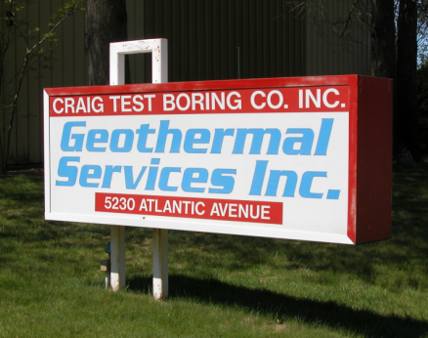
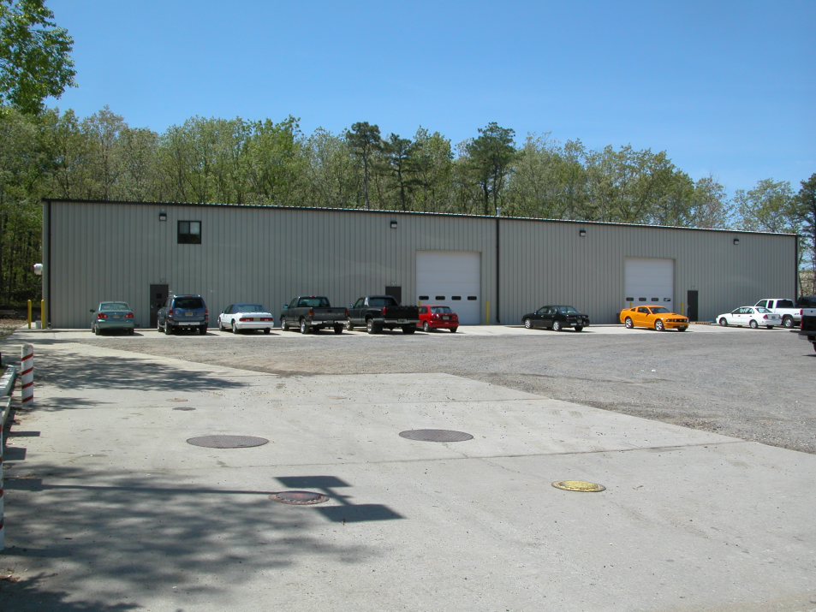
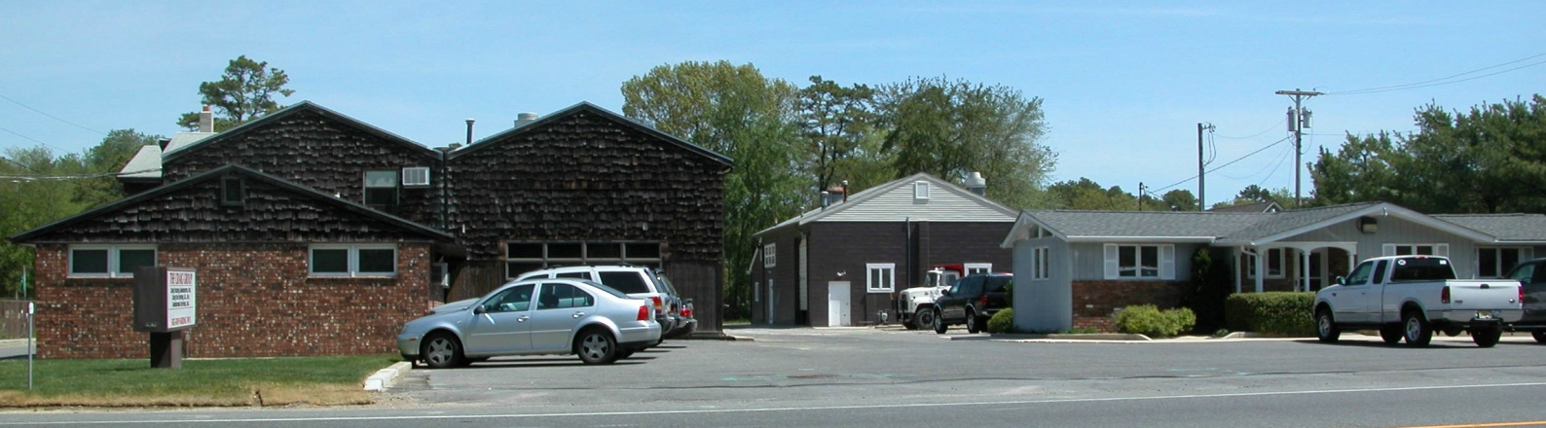
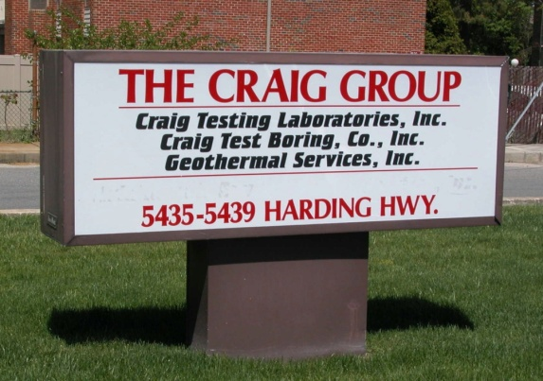
Home - About GSS - Services - Resources - Contact Us
For more information, contact us at:
Ground Source Solutions, LLC
P.O. Box 427
5435 Harding Highway
Mays Landing, NJ 08330
Phone: (609) 625-8565
Fax: (609) 625-8719
Email: info@groundssllc.com

